Slide 1










MILESTONE
ACADEMY
PRESENTS
2024-25
1

Slide 2






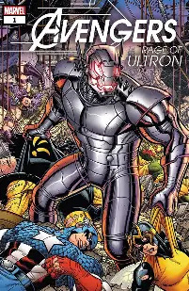





MILESTORIES
By Millestonians
2

Slide 3


LITERTARY CLUB
Left out
for images
Design still in progress

